Slide 1
Changes to Executive Committees
Notes:
Introduce yourself - Transformation Lead for Wiltshire, Cub Leader in Salisbury
Introduce Justin – County Chair
Questions in chat

Slide 2
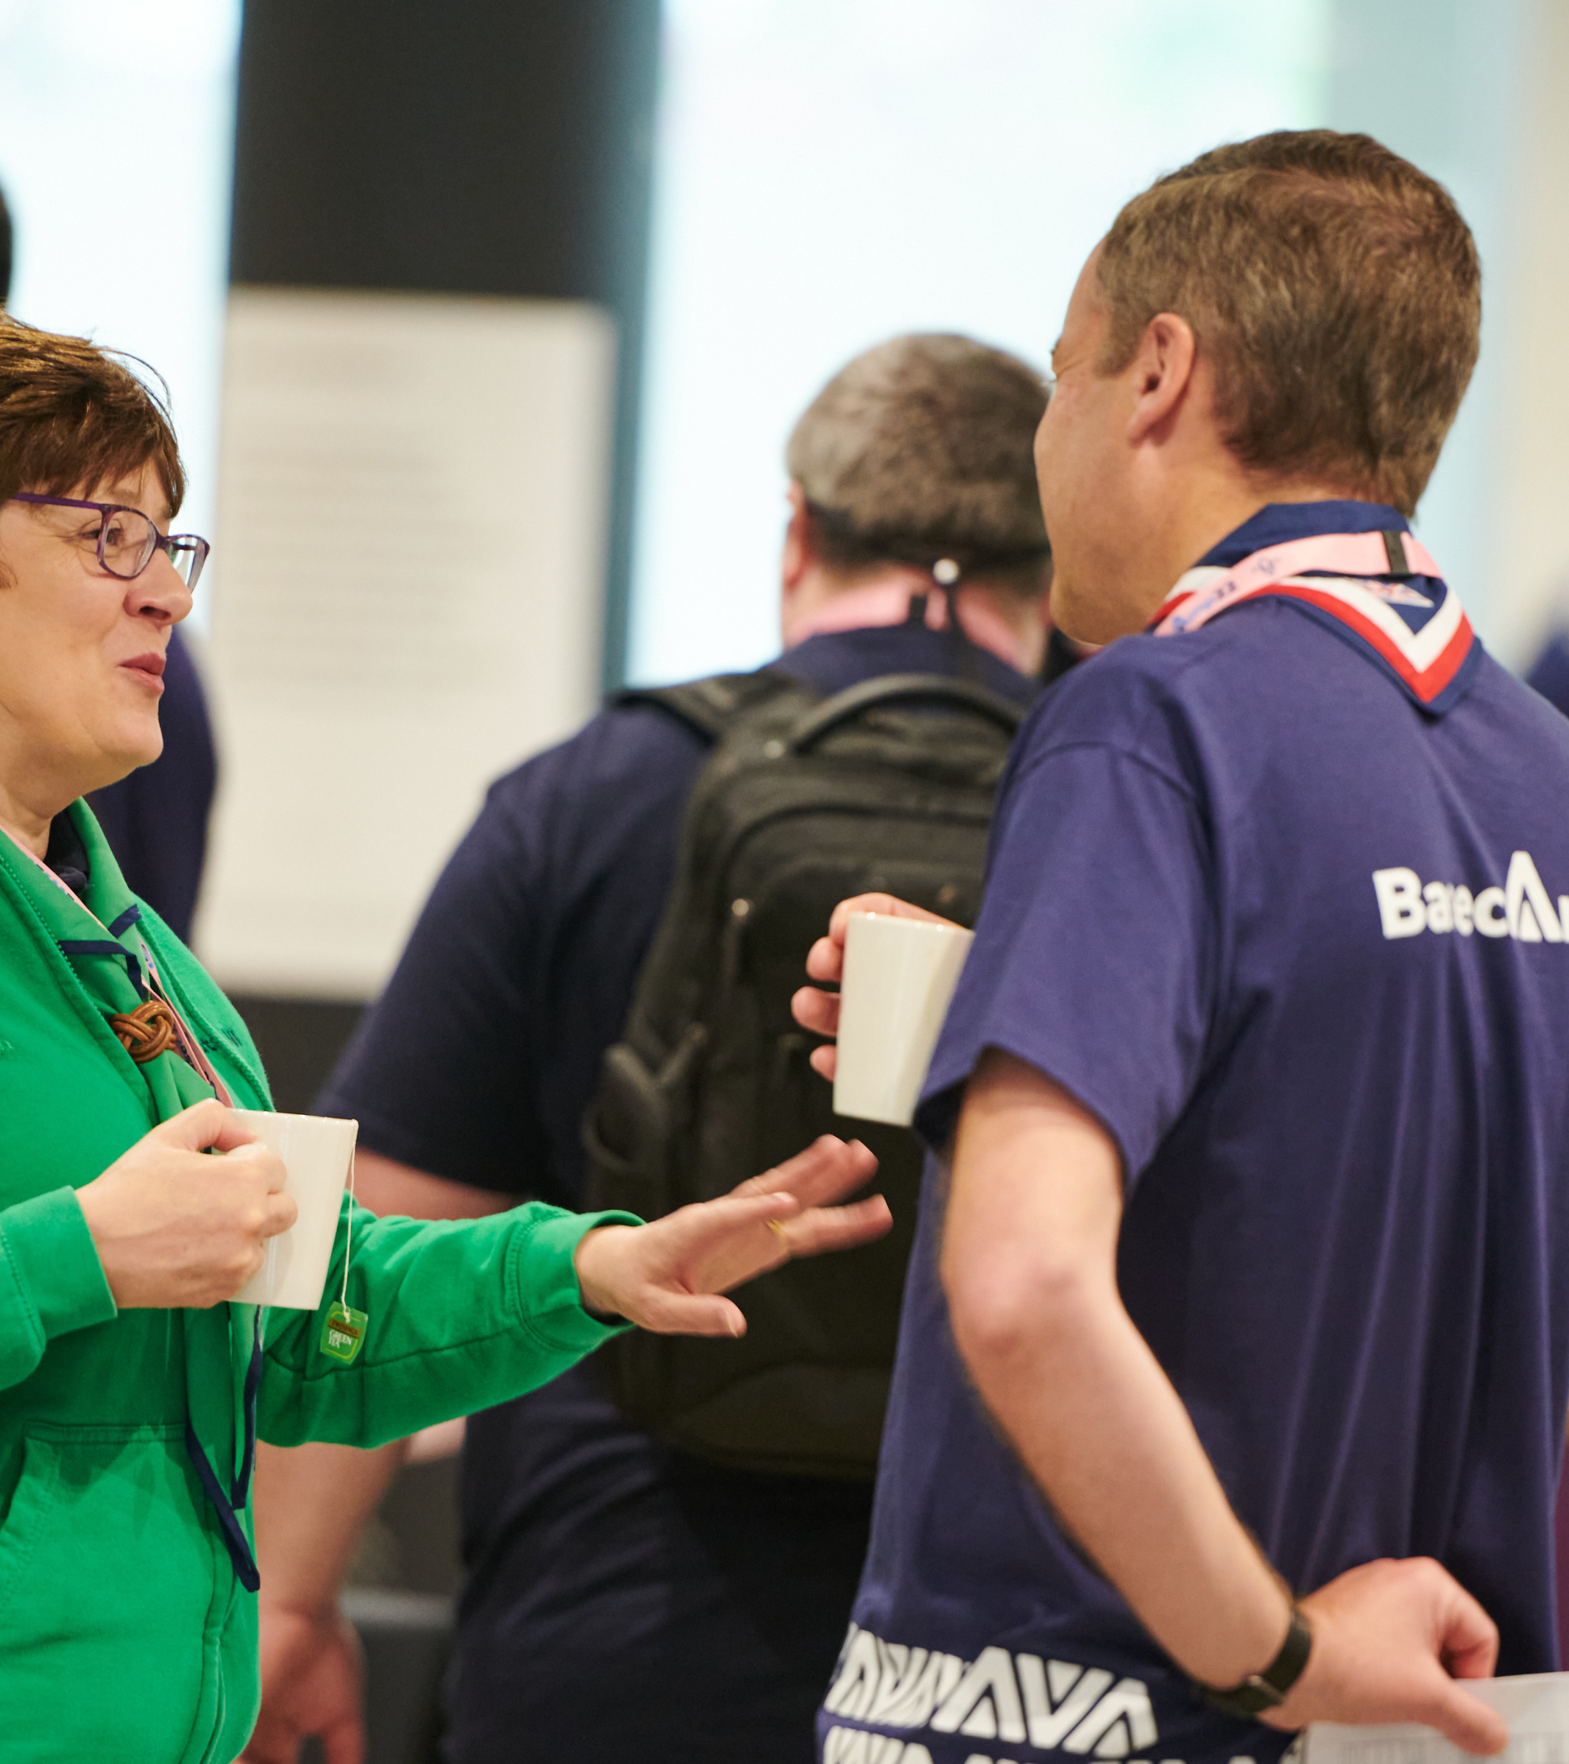
Transitioning to Trustee Boards
Introduction
Introduction
As part of the work to transform the volunteer experience within Scouts there will be changes to Executive Committees and how they function.
These changes are informed by:
The evolution of good practice guidance from charity regulators
Our move to a teams-based approach.
These cultural and procedural changes to how Executive Committees currently operate will support our Skills for Life strategy, our ‘North Star’ and the overall aims of the volunteer experience transformation.
Notes:
As part of the wider transformation programme, there will be some changes to Executive Committees and how they function.
This slidepack will provide you with the information you need to share with the rest of your teams, to ensure continued compliance with POR and other legal requirements.
These changes have been informed by some of the wider transformation focus areas, as well as changes to good practice guidance from charity regulators.

Slide 3
Making volunteering easier and more fun is how we reach our North star...
More young people gaining skills for life
Consistently and safely
deliver a great programme
Recruit more volunteers
and retain current ones
Notes:
Our transformation programme as a whole is designed around this, our north star.
We always aim to provide more young people with skills for life, but we can’t do that without the support from adult volunteers. As we know, recruiting and retaining volunteers is challenging in some areas for a variety of reasons. The changes involved in this programme will help us grow our adult volunteer teams, leading to further growth in our youth membership.

Slide 4
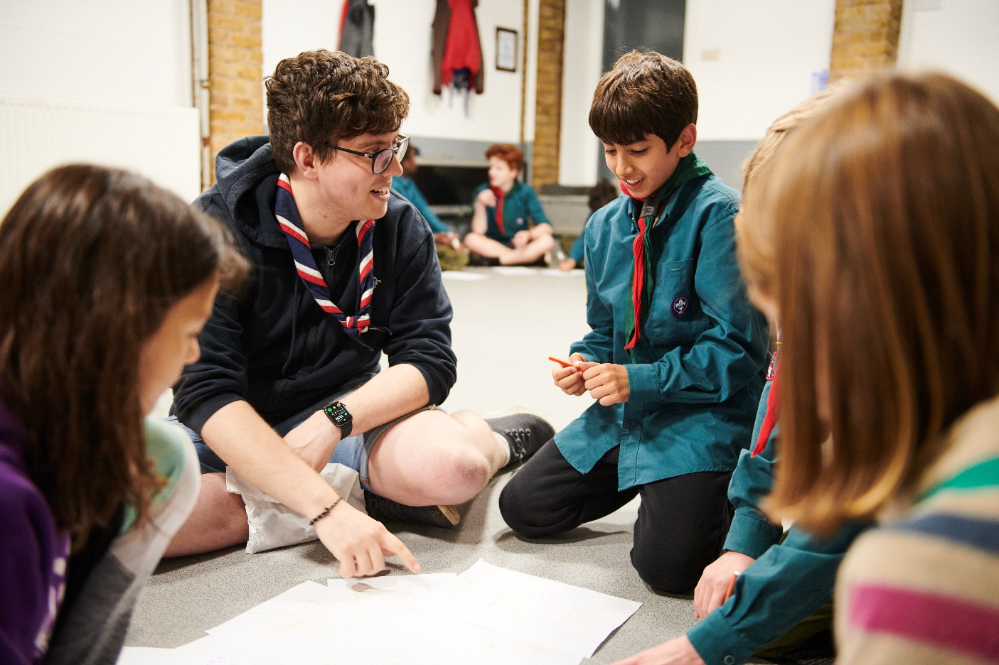
Transitioning to Trustee Boards
Introduction
Why we’re transforming volunteering
To provide more young people, and the ones we already have, with skills for life, we need more volunteers
Every volunteer deserves to feel valued during their time with Scouts
The world is changing, and volunteers want more flexibility in the time they give
Ultimately…..
Notes:
We understand that the world of volunteering has changed over the last few years, and it continues to do so today.
We need to remain flexible in our approach to volunteering, to make sure every adult volunteer feels valued for the work they do.
That flexibility needs to be offered directly to adult volunteers, not by exception but as standard.

Slide 5
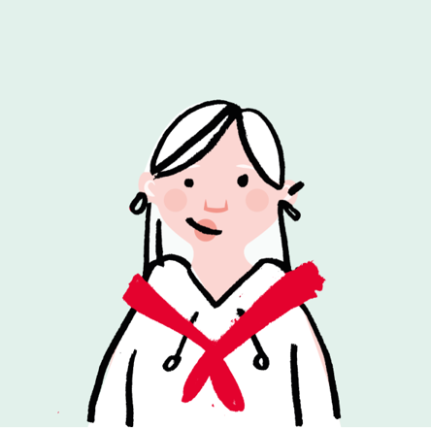
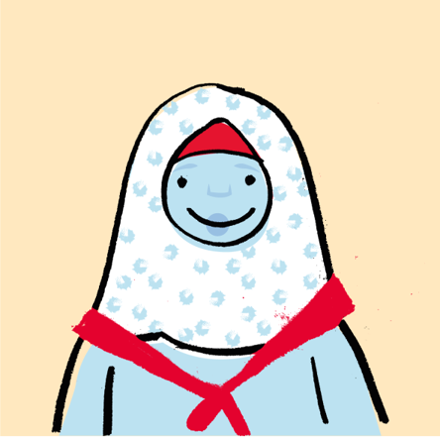
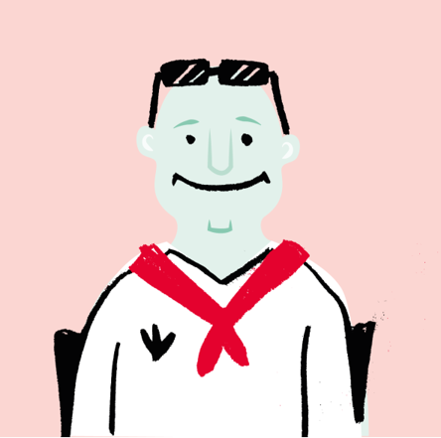
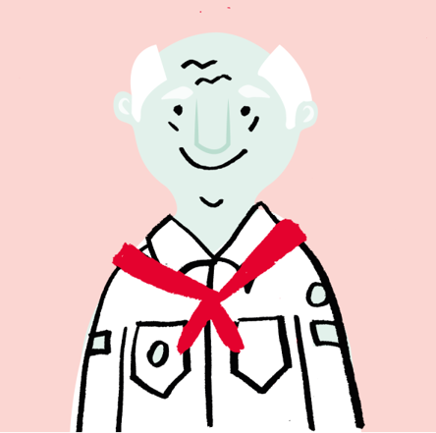
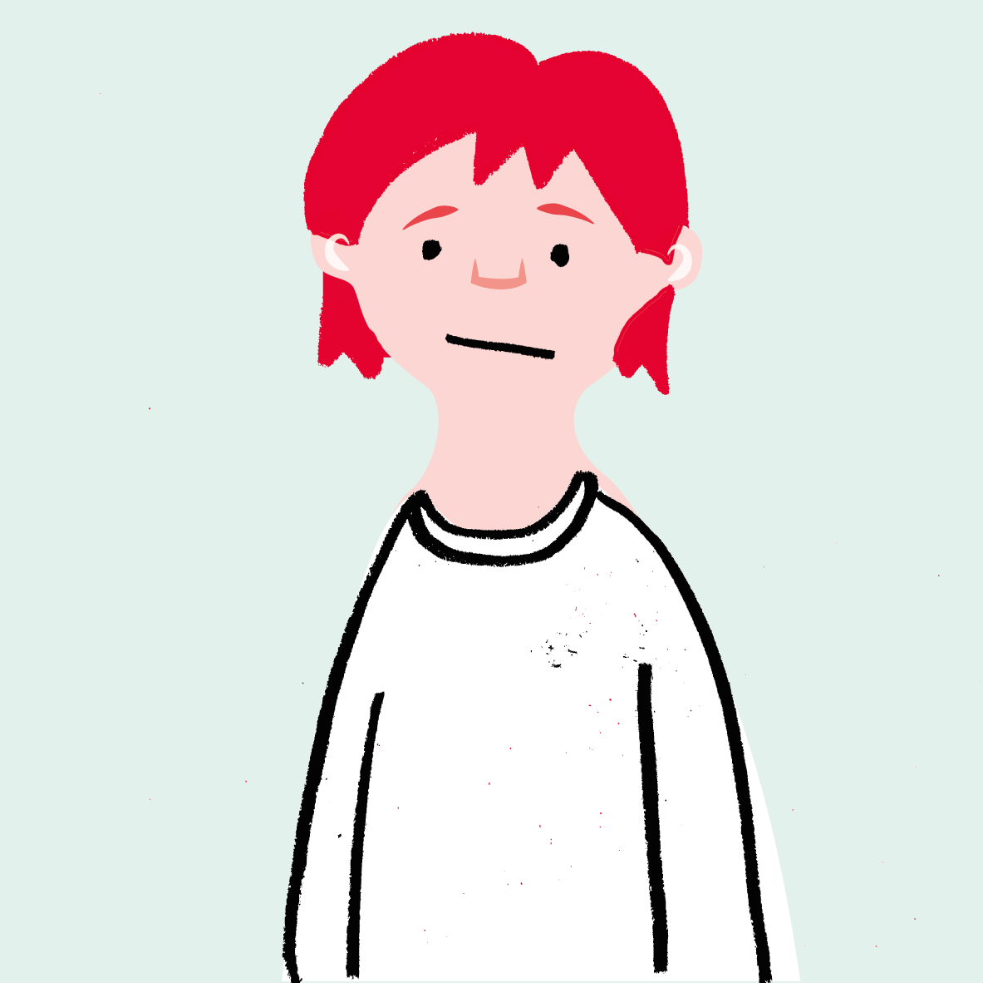
Transitioning to Trustee Boards
Introduction
We want to make volunteering with Scouts easier and more fun…
…so that we can attract more volunteers and our current volunteers want to stay
Notes:
And this is one of our key aims.
By making volunteering easier and more fun, we can find more volunteers to join our amazing teams that already do a great job. And those current volunteers will want to stay too!

Slide 6
Transitioning to Trustee Boards
Introduction
The culture we need to build…
Welcoming
Supportive
Digitally Enabled
Inclusive
Learning, not training
Clearer Roles
Notes:
The first key change is to our volunteering culture.
We want to build a culture that is welcoming and inclusive to all, with built in support to help you get things done.
We are encouraging a new learning culture, and making our roles and structures easier to understand by everyone.
All of these changes will be supported by new digital tools, which helps us move towards a digitally enabled culture.

Slide 7
Transitioning to Trustee Boards
Introduction
How have these changes been designed?
Ensuring these changes practically support our volunteers is extremely important. To that end we have:
Volunteers leading alongside staff on each area of change
A volunteer experience group, open to all our volunteers, to help shape the changes
The digital membership testing group, open to all our volunteers, to help test and shape our digital tools
An early adopter cohort of 10 different areas across the UK who will go first with the changes and help to shape the resources and support available
Notes:
Lots of research has been done across the last 5 years, with a very diverse audience including adults from both within the organisation, as well as externally.
There has been lots of consultation with fellow volunteers to understand their views on these upcoming changes. You may have provided feedback yourself via the HQ Testing Hub.
There is also a group of early adopter counties who will take on the changes early to provide feedback to the change teams at HQ before the wider transition takes place.

Slide 8
Transitioning to Trustee Boards
Introduction
Listening to our volunteers, young people and more we’ve identified three key areas for change:
Providing a warmer welcome for everyone
Delivering a more engaging learning experience
Simplifying how we volunteer together
All of which will be supported by easy-to-use digital tools
Notes:
The outcome of that research was that changes need to be made in these 3 core focus areas. These are;
Providing a warmer welcome for everyone
Delivering a more engaging learning experience
Simplifying how we volunteer together
And all of these areas will be supported with new easy to use digital tools

Slide 9
Transitioning to Trustee Boards
Moving to a team-based approach
Part of the Simplifying Volunteering Focus Area

Slide 10
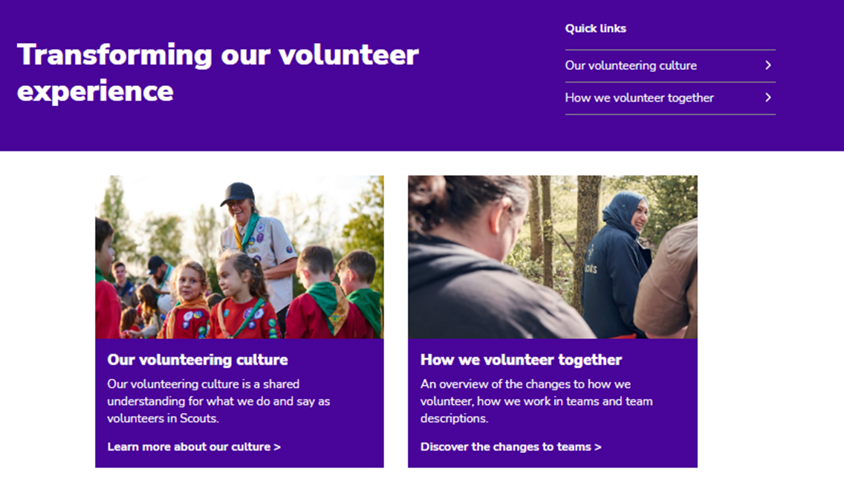
Transitioning to Trustee Boards
Moving to a team-based approach
Moving to a team-based approach
The key principles for these new teams are to:
Allow for flexible volunteering that suits people’s skills, interests, and time
Provide clear purpose and responsibilities to ensure our volunteers and young people have the required support
Have tasks that will be shared among a team
Be led by a Team Leader or Lead Volunteer
Notes:
By moving to a team based approach, we will be able to offer more flexibility in our tasks and roles, as well as being able to offer roles suitable to peoples skills, interests and time.
We will have new team descriptions, providing a clear purpose and responsibilities to ensure our volunteers and young people have the required support.

Slide 11
Transitioning to Trustee Boards
Moving to a team-based approach
Section & Group Structure
Team Leader(s)
Sections
Team Member
Team Member
Section Team
Group
Young Leader
Team Member
Young Leader
Group Leadership Team
Trustee Board

Slide 12
Transitioning to Trustee Boards
Moving to a team-based approach
District & County Structure
Young Leaders
Explorers
Trustee Board
Leadership Team
Trustee Board
Leadership Team
14 - 24 Team
Network
County
Districts
District
Volunteering Development Team
Volunteering Development Team
Groups
Programme Team
Support Team
Programme Team
Support Team

Slide 13
Transitioning to Trustee Boards
What’s changing for Trustee Boards
Justin – County Chair

Slide 14
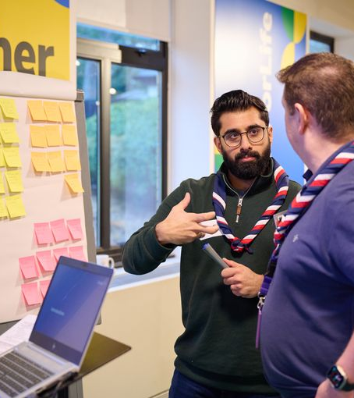
Transitioning to Trustee Boards
Introduction
Setting up for success
Good governance is fundamental to a charity's success, enabling and supporting the charity to:
Comply with the law and relevant regulations
Meet the charity’s objectives
Good practice for this is set by the charity regulators, where there have been significant changes over the past few years.

Slide 15
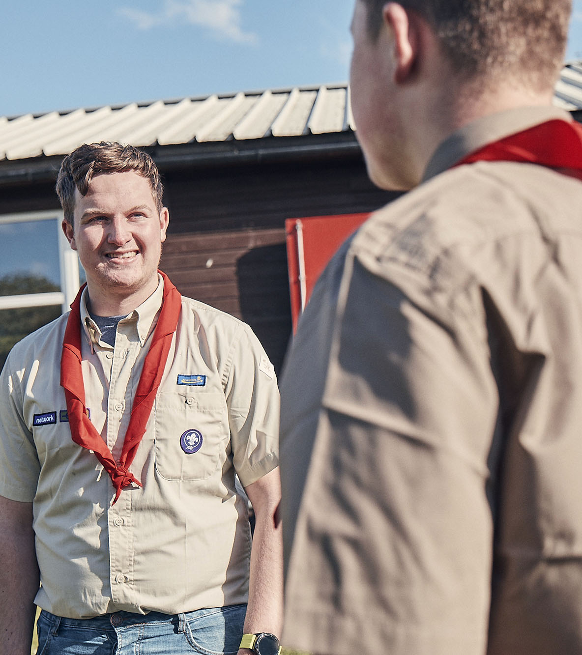
Transitioning to Trustee Boards
What’s changing?
Our current position
Many Groups, Districts and Counties (or equivalent) have Executive Committees which oversee a mixture of governance and operational tasks.
Governance processes such as risk and financial management, are often not carried out or well supported.
Charities must adopt a constitution. On census 2023 within Wiltshire, 49% of Groups and Districts said they had not adopted a constitution or didn’t know if they had.

Slide 16
Transitioning to Trustee Boards
What’s changing?
What’s changing?
Name
Purpose
To bring our current structure in line with the good practice guidance set out by the charity regulators there are currently two key areas of change
Name
Executive Committees will be renamed Trustee Boards, members of which will be renamed Trustees
Purpose
Trustee Boards will have a clearer purpose statement, to fit with the focus on governance

Slide 17
Transitioning to Trustee Boards
What‘s changing?
Renaming as Trustee Boards
Executive Committees are renamed as Trustee Boards, members of which are renamed as Trustees
Why is this changing?
To align with good practice guidance from the charity regulators
To help reinforce the purpose of Trustee Boards and focus on the role and responsibilities of being a charity Trustee

Slide 18
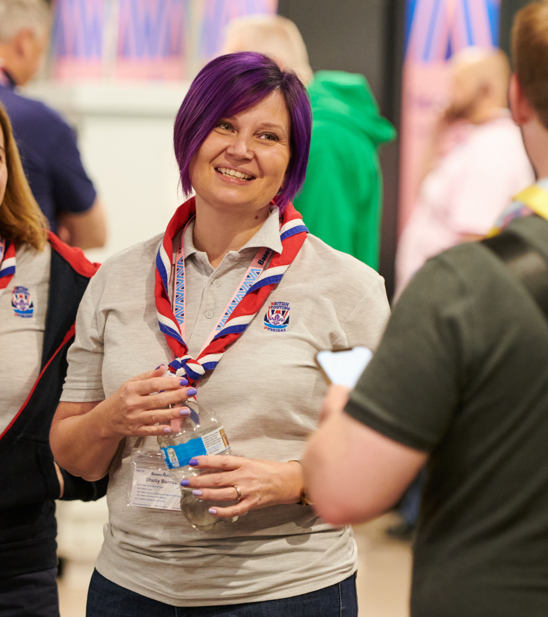
Transitioning to Trustee Boards
What’s changing?
Renaming as Trustee Boards
When is this changing?
From publication of POR in mid-April 2023 onwards
This renaming happens from the release of POR and does not need to be adopted or approved through AGMs (Some areas have already made this change)
What will be the changes in POR?
The April 2023 edition of POR will reference Trustee Boards and Trustees instead of Executive Committees and Executive Committee members respectively, in all chapters

Slide 19
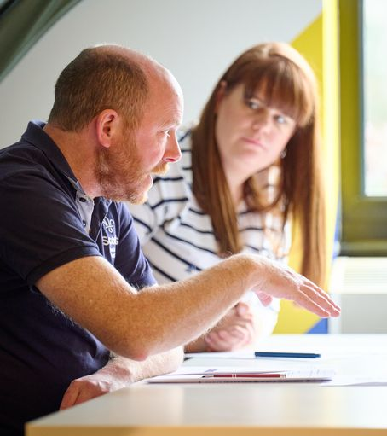
Transitioning to Trustee Boards
What‘s changing?
The purpose of Trustee Boards
Trustee Boards have a clearer purpose statement, to fit with the focus on governance. This will mean ‘operational’ tasks are managed through the Group Leadership Team or the Support Team in District or County.
Why is this changing?
To align with good practice guidance from charity regulators
To focus on ensuring effective governance. This is the core of any charity Trustee Board’s responsibility and an important part of ensuring that the charity focusses on meeting its objectives

Slide 20
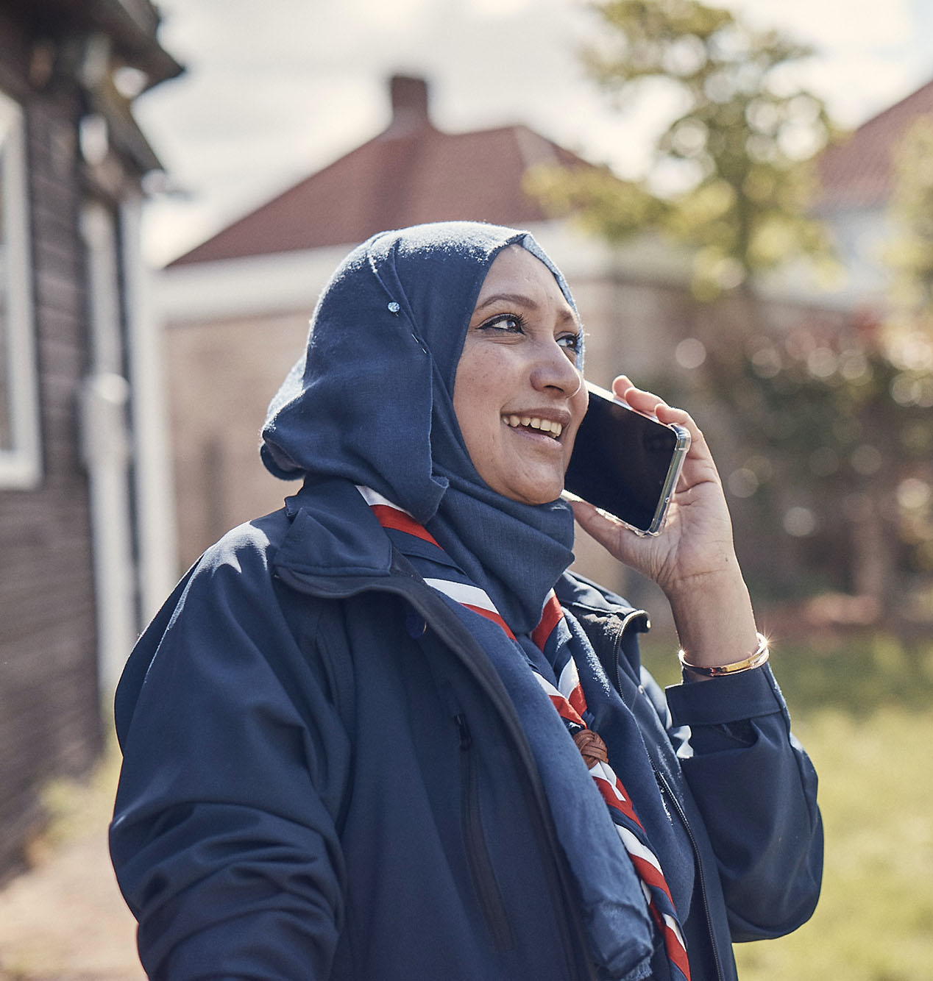
Transitioning to Trustee Boards
What’s Changing?
The purpose of Trustee Boards
When is this changing?
From publication of POR in mid-April 2023
Those who have already adopted the constitution as set out in POR - This change can happen from the release of POR and does not need to be adopted or approved through AGMs
For those who have not adopted the POR constitution - This change can be informally adopted and worked towards from the release of POR and will then need to be confirmed at the next AGM
What will be the changes in POR?
The April 2023 edition of POR, will contain the updated ‘Trustee Board Purpose’ statements within chapter 5

Slide 21
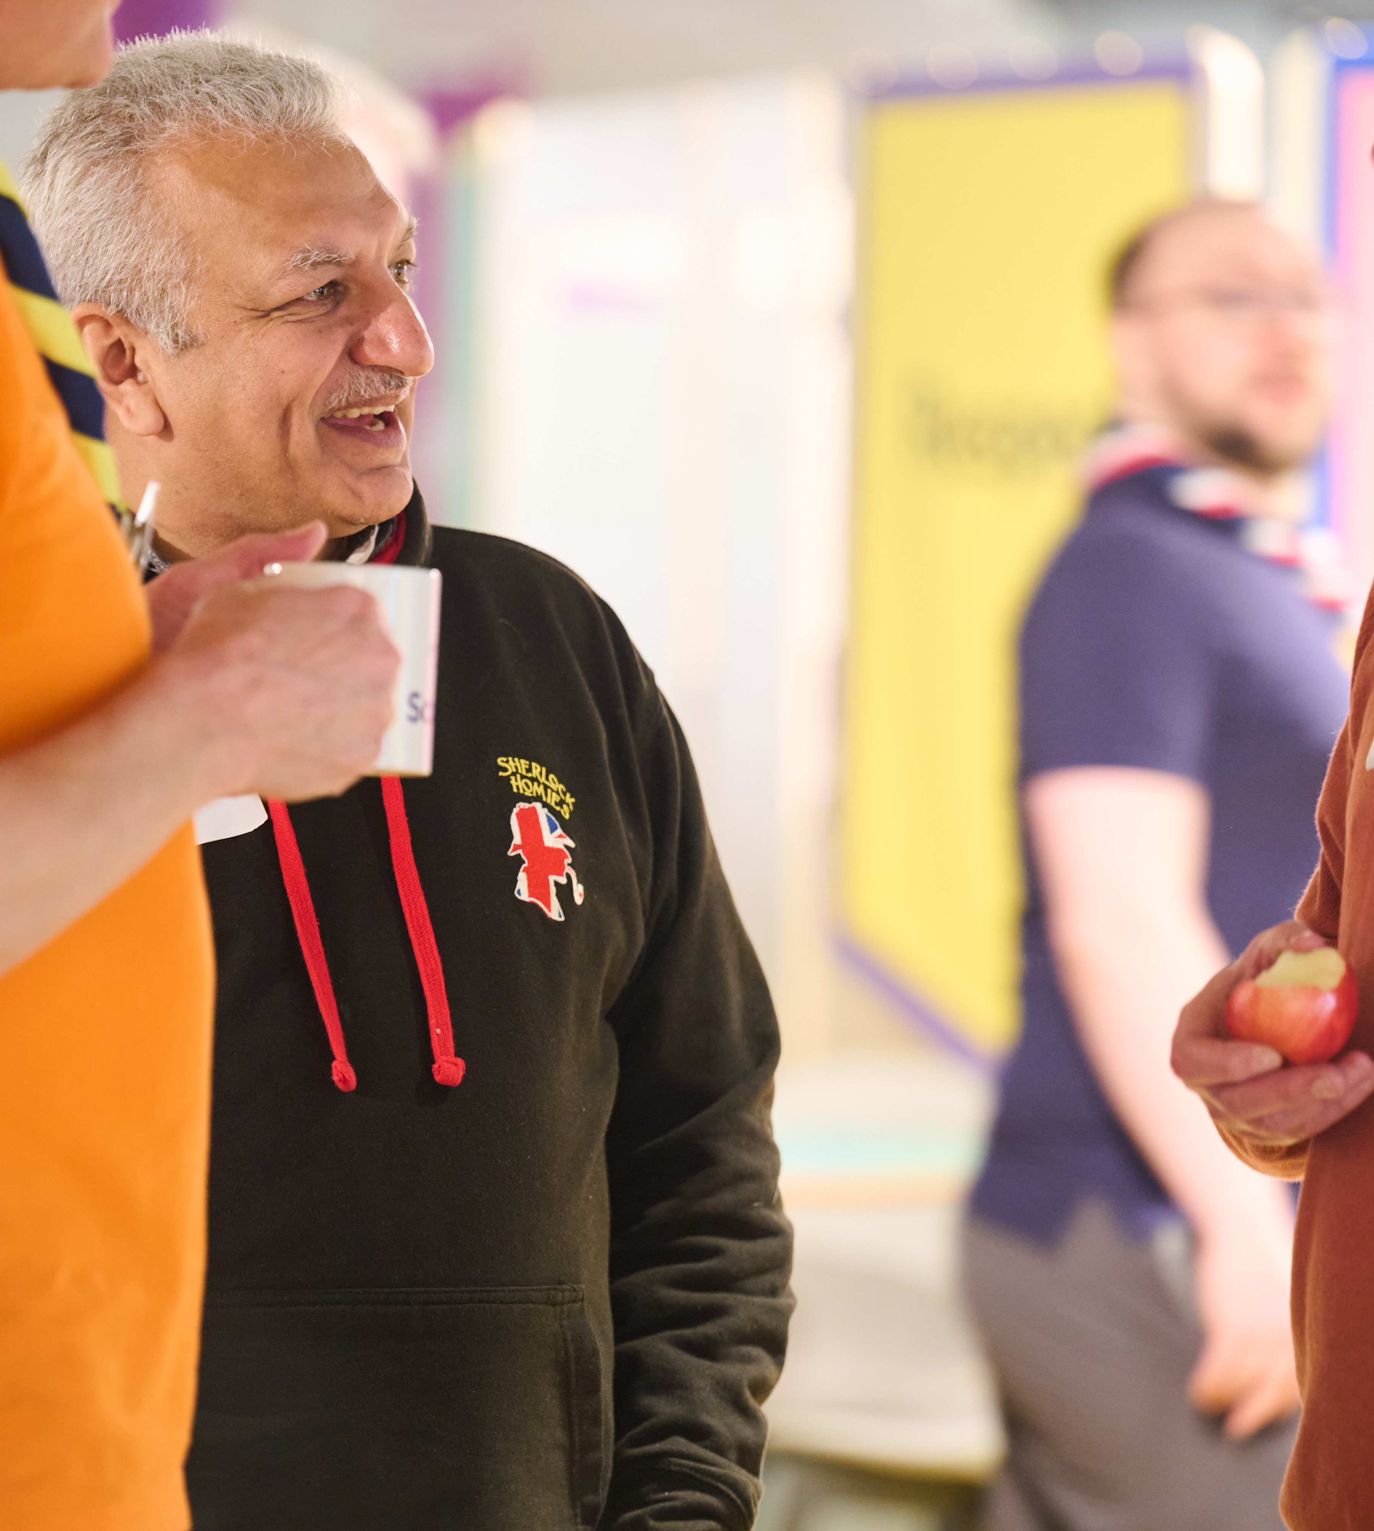
Transitioning to Trustee Boards
What’s changing?
The purpose of Trustee Boards
What will this look like in practice?
Some areas will be for trustees to be confident that they are being done. This is different from doing it themselves!
Some areas will be for trustees themselves collectively to do. These are the core governance tasks.
This will mean that ‘operational’ tasks such as repairing the hut, cutting grass, fundraising and similar are managed through the Group Leadership Team, or the Support Team in a District or County.
These operational tasks can be carried out by people who are also Trustees, however, they will be managed under the relevant team rather than in their Trustee role.

Slide 22
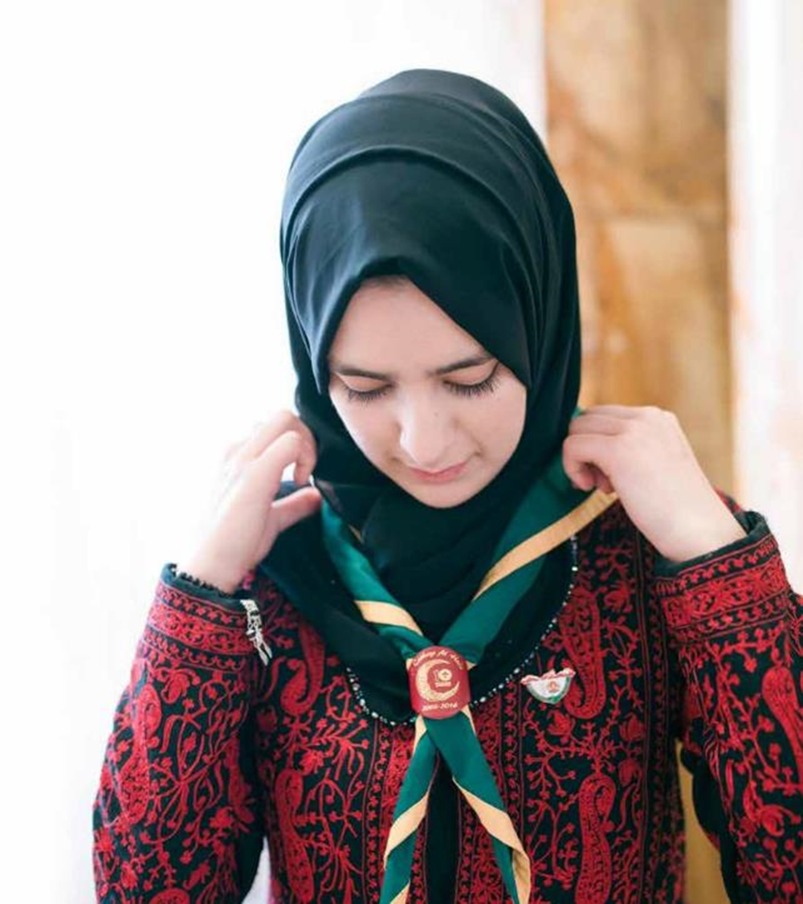
Transitioning to Trustee Boards
What’s changing?
Additional tasks
In addition to the changes mentioned above, support should be provided to all Trustee Boards to ensure they have adopted a constitution. Whilst this is not a change in POR, it is important that this is done.
This should be either:
The constitution as set out in POR
An adapted version of the constitution as set out in POR
Why?
This has been a requirement of Annual General Meetings since 2011 (and was more clearly called out in POR in 2021). It continues to be a requirement for Trustee Boards

Slide 23
Transitioning to Trustee Boards
What’s changing?
Additional tasks
When should this be done?
It is important that the model AGM agenda outlined in the April 2023 edition of POR Chapter 5 is followed from the next AGM where possible
For 2023 AGM agenda planning, 5.4.5 from the January 2023 edition of POR will not be significantly different. (The April 2023 edition tidies up that wording but doesn't make fundamental changes.)
Resources to support the POR changes will be shared soon.

Slide 24
Transitioning to Trustee Boards
Next Steps

Slide 25
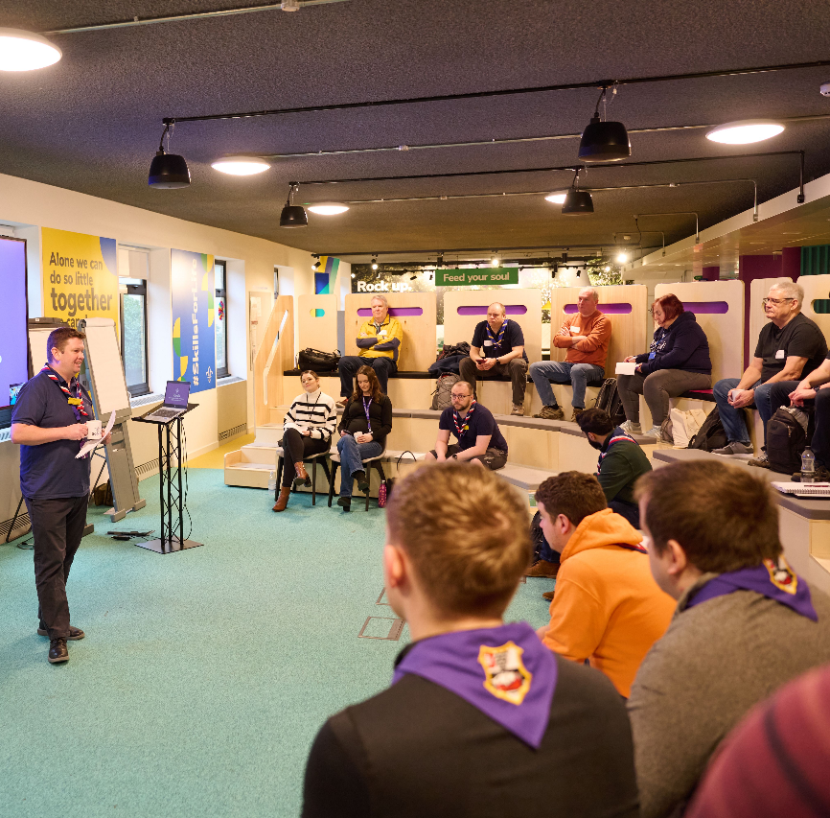
Transitioning to Trustee Boards
Next Steps
Next steps
From April 2023 POR release
Trustee Board name and purpose change:
For Group/District/County Scout Councils who have adopted the constitution as per POR, these can be introduced without needing approval at an AGM
For Scout Councils who have not adopted the constitution as per POR, these can be informally introduced and then formally adopted at the next AGM
At the next AGM
Ensure a constitution has been adopted or re-adopted

Slide 26
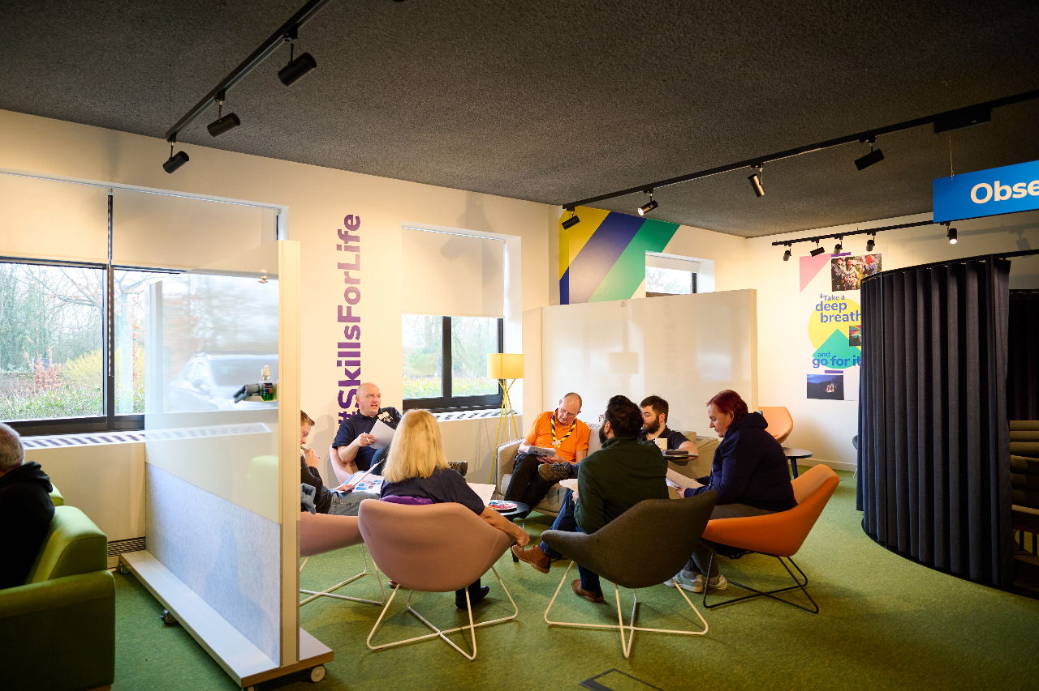
Transitioning to Trustee Boards
What’s changing?
Summary
These changes are an important first step to ensuring effective governance by all Trustee Boards at Group, District and County. Changes to the name and purpose of Trustee Boards is the core part of this transition
There may be further changes from the point at which we transition to the new digital tools as part of the wider transformation programme. Any further developments will be communicated later in the year.

Slide 27
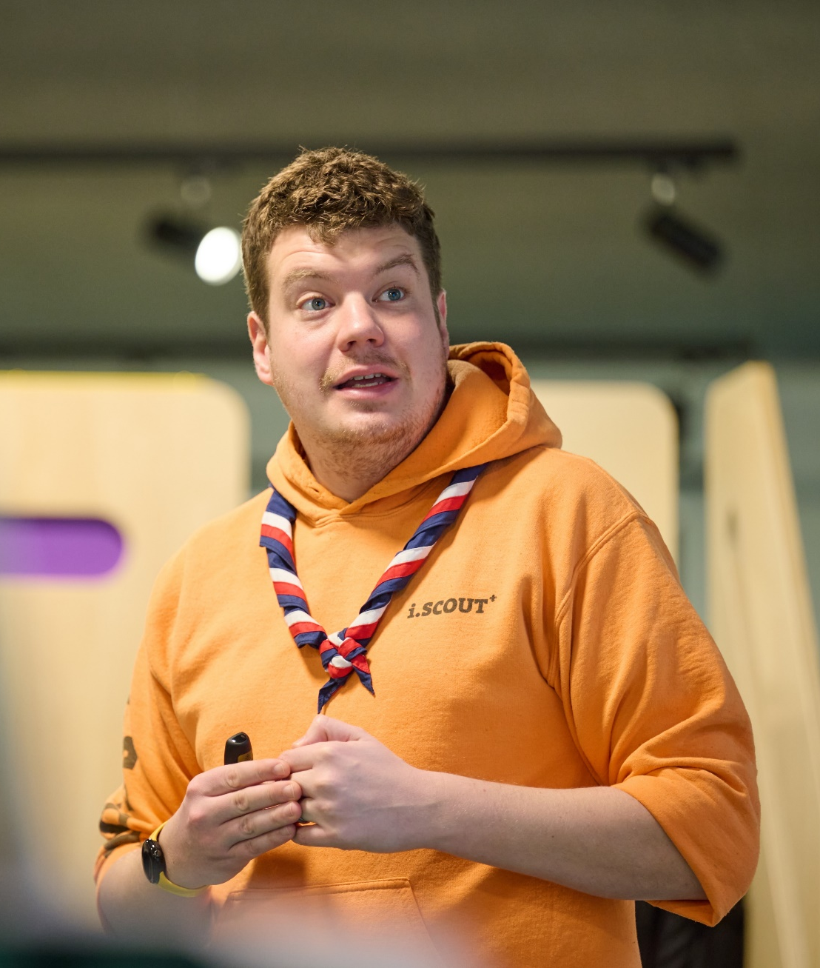
Transitioning to Trustee Boards
Next Steps
Outcomes
It is recognised that different Trustee Boards, for a variety of reasons, will take different lengths of time to be fully aligned with the new purpose statements
The important part is that all Trustee Boards are working towards reflecting best practice as outlined in POR

